Slide 1
Chapter 17: Optimization Models with Uncertainty
Business Analytics: Methods, Models,
and Decisions, 1st edition
James R. Evans

Slide 2
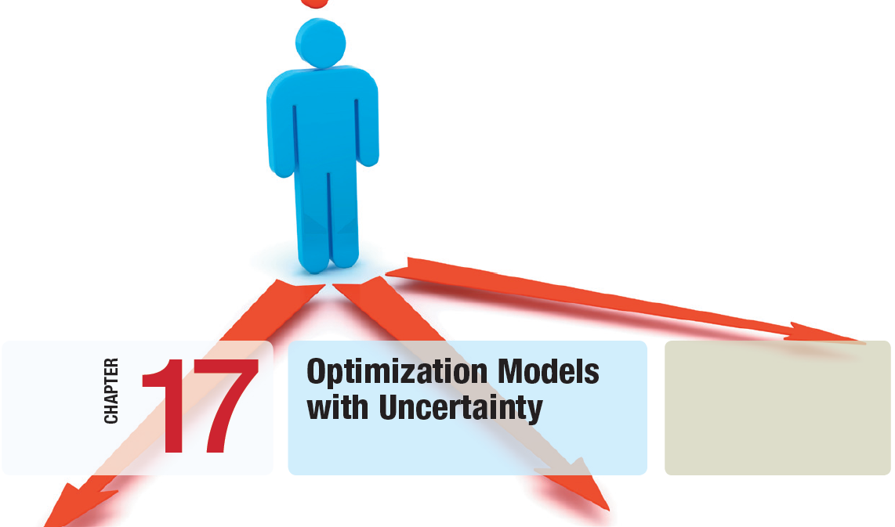

Slide 3
Chapter 17 Topics
Risk Analysis Optimization
Optimizing Monte Carlo Simulation Models
Simulation Optimization Using Risk Solver Platform

Slide 4
Risk Analysis Optimization
In the chapters on linear, integer, and nonlinear optimization, we used deterministic models.
In most situations, some of the data will be uncertain, which implies inherent risk.
Stochastic models incorporate uncertainty.
Problem-solving approaches in this chapter:
- Risk analysis of simulated models
- Multiple parameterized simulations
- Optimization using simulation
- Optimization using Evolutionary Solver

Slide 5
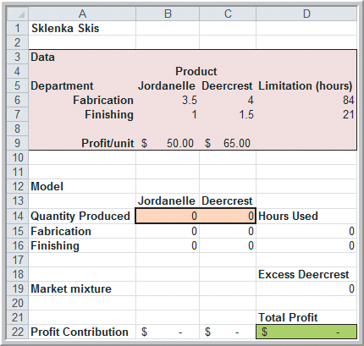
Risk Analysis Optimization
Example 17.1 Uncertainty in the Sklenka Ski Model
Recall the Sklenka Ski model, which maximizes profit on skis produced subject to constraints on:
- Fabrication labor hours
- Finishing labor hours
- Market mixture
Now suppose the labor hours
for finishing each type of ski
is stochastic, following
triangular distributions.
Overtime is needed for more
than 21 hours finishing.
Figure 17.1

Slide 6
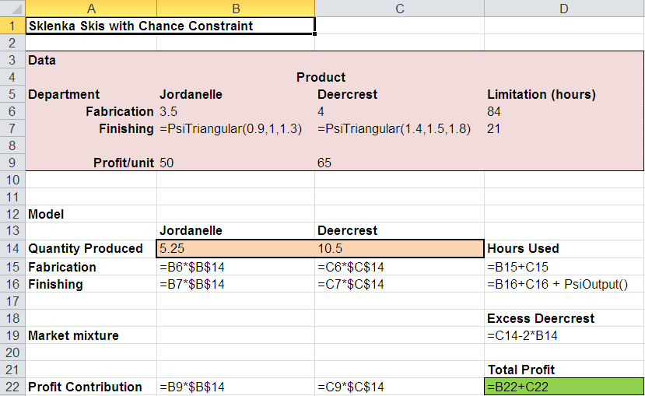
Risk Analysis Optimization
Example 17.1 (continued)
Uncertainty in the Sklenka Ski Model
Specify the finishing time input distributions in cells B7 and C7.
Specify the available finishing hours as an uncertain output cell D16.

Slide 7
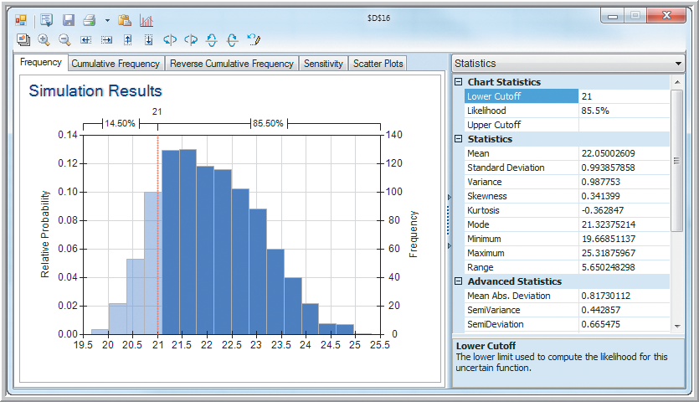
Risk Analysis Optimization
Example 17.1 (continued)
Uncertainty in the Sklenka Ski Model
Risk Solver Platform
Simulate
Run Once
Double click on D16.
The likelihood of needing overtime is 85.5%
Figure 17.2

Slide 8
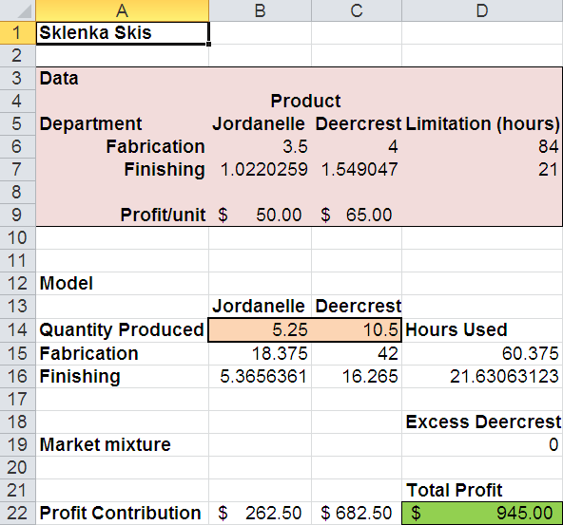
Risk Analysis Optimization
Example 17.1 (continued)
Uncertainty in the Sklenka Ski Model
With uncertain finishing times, the simulation results indicate the same number of skis produced but, on average, 0.63 hours of overtime are needed.

Slide 9
Risk Analysis Optimization
Chance Constraints
Specify the fraction of simulation trials that must satisfy a constraint
Value at risk (VaR) constraints must be satisfied at least p% of the time.
Conditional at risk (CVaR) constraints place bounds on the average magnitude of all violations of the constraint that may occur (1−p)% of the time.
CVaR is more conservative than VaR.

Slide 10
Risk Analysis Optimization
Example 17.2
Solving the SSC Model with a Chance Constraint
Sklenka Skis wants to determine a production schedule that has no more than a 10% probability of overtime being required.
That is, they want a 90% probability of needing 21 or fewer hours of finishing labor.
When simulating, we can specify a VaR chance constraint instead of the original finishing constraint.

Slide 11
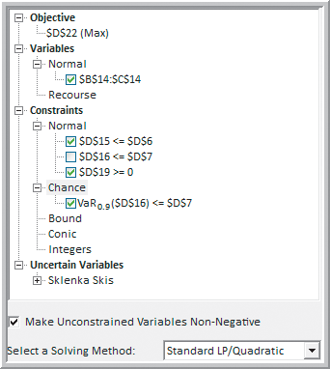
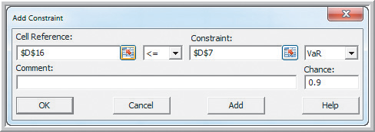
Risk Analysis Optimization
Example 17.2 (continued)
Solving the SSC Model with a Chance Constraint
Risk Solver Platform
Constraints
Chance Constraints, ≤
D16 ≤ D7
VaR
Chance: 0.90
Figure 17.3
Figure 17.4

Slide 12
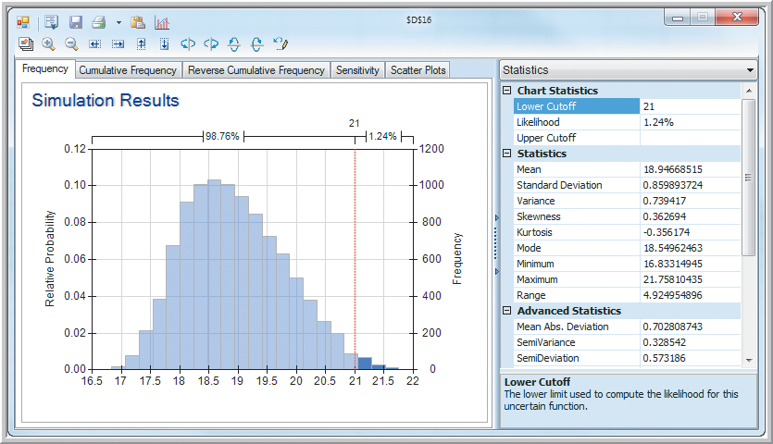
Risk Analysis Optimization
Example 17.2 (continued)
Solving the SSC Model with a Chance Constraint
The likelihood of needing overtime is only 1.24%.
Figure 17.6

Slide 13
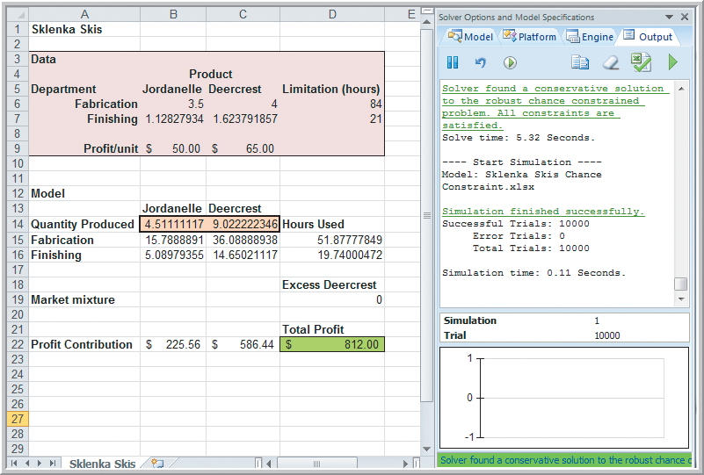
Risk Analysis Optimization
Example 17.2 (continued)
Solving the SSC Model with a Chance Constraint
On average, there are 1.26 unused finishing hours due to producing fewer Deercrest skis.
Click on the red circled green arrow to improve the solution.
Figure 17.5

Slide 14
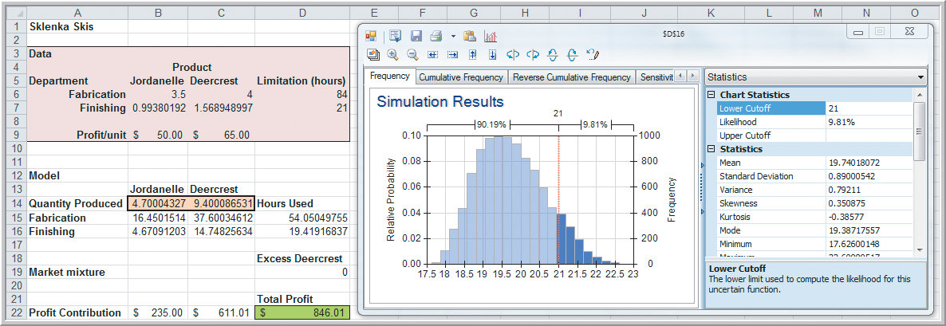
Risk Analysis Optimization
Example 17.2 (continued)
Solving the SSC Model with a Chance Constraint
The likelihood of needing overtime is now closer to the desired 10% level.
Figure 17.7

Slide 15
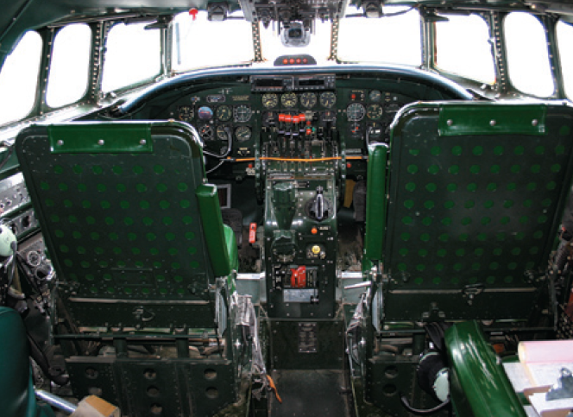
Risk Analysis Optimization
Analytics in Practice: Using a
Chance-Constrained Optimization
Model at Lockheed Martin
Lockheed Martin Space Systems needed a robust analytical model to optimize project selection for site maintenance.
The Facilities Operations and Services department developed chance-constrained spreadsheet models to address risks and constraints inherent in capital-rationing problems.
Lockheed Martin’s managers and analysts gained many insights from these models.

Slide 16
Risk Analysis Optimization
Service Levels in the EOQ Model
The standard EOQ model assumes constant deterministic demand.
In most practical situations, demand is stochastic.
Monte Carlo simulation allows us to generate stochastic demand.
We can estimate the reorder point and safety stock that minimize inventory costs.

Slide 17
Risk Analysis Optimization
Example 17.3
Finding the Distribution of Lead-Time Demand
Recall the EOQ Example 16.5.
Annual demand for a product is 15,000 units.
Ordering costs are $200 per order.
Purchase cost is $22 per item.
Carrying charge rate is 20%.
Now assume demand is normally distributed with a mean of 15,000 units and a standard deviation of 2,000 units.

Slide 18
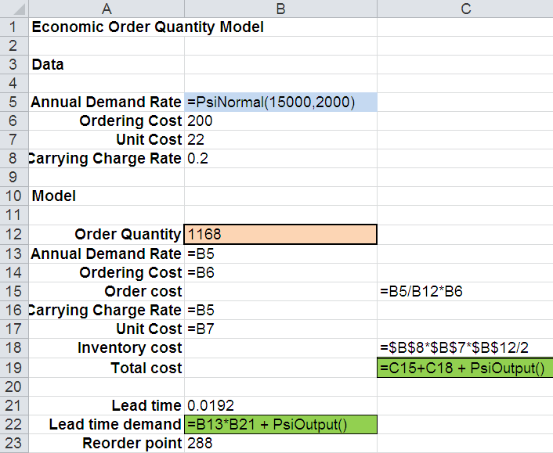
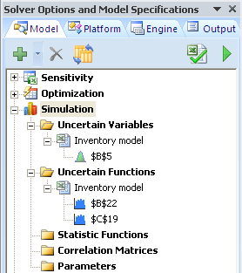
Risk Analysis Optimization
Example 17.3 (continued)
Finding the Distribution of Lead-Time Demand
Specify demand in B5.
Changing output cells:
B22 and C19
From Figure 17.8

Slide 19
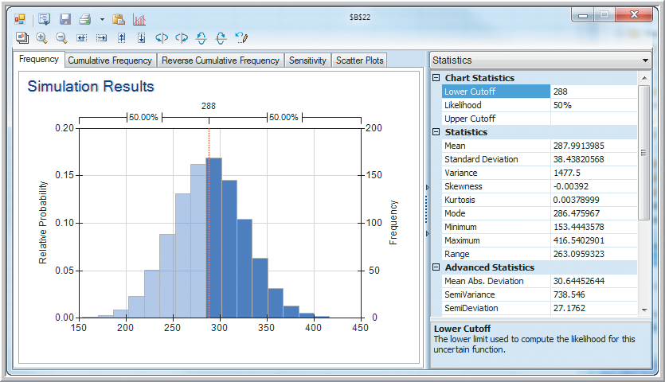
Risk Analysis Optimization
Example 17.3 (continued)
Finding the Distribution of Lead-Time Demand
Using a reorder point of 288 would result in 50% chance of a stock-out.
Figure 17.9

Slide 20
Risk Analysis Optimization
Example 17.4 Finding the Reorder Point for a Service Level Requirement
In the stochastic EOQ model, use a service level constraint to ensure that demand can be satisfied 95% of the time.
Identify the reorder point required to meet this service level.
This can be done using the lead time demand distribution from the previous example.

Slide 21
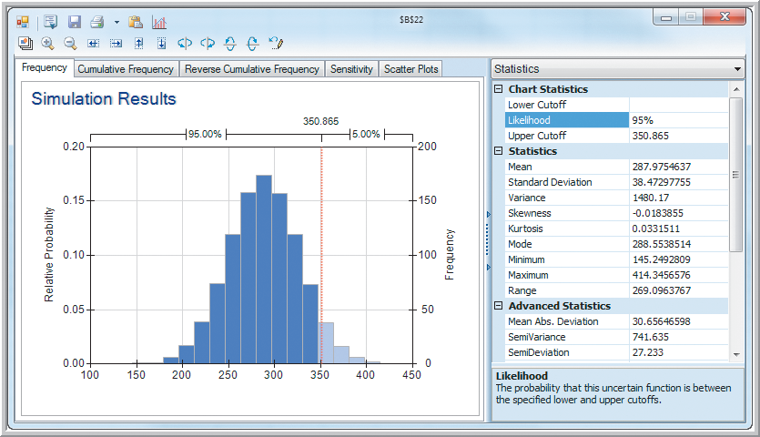
Risk Analysis Optimization
Example 17.4 (continued) Finding the Reorder Point for a Service Level Requirement
Lower Cutoff: 0
Likelihood: 95%
Reorder point
= 351
Safety stock
= 351−288
= 63
Figure 17.10

Slide 22
Risk Analysis Optimization
Example 17.5 Simulating the Optimal Solution to the Hotel Pricing Model
Recall from Example 16.2 that the Marquis Hotel is considering a major remodeling effort.
Hotel management needs to determine the best combination of rates and room sizes to maximize revenues while keeping the number of rooms at no more than 450.
Room rate price ranges:
$70-$90 for standard
$90-$120 for gold
$120-$149 for platinum

Slide 23
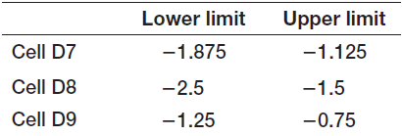
Risk Analysis Optimization
Example 17.5 (continued) Simulating the Optimal Solution to the Hotel Pricing Model
In Example 16.2 price-demand elasticities were assumed constant.
Now it is believed the elasticities can vary by ± 25% from their estimates, as shown below.
Use uniform distributions for these elasticities.
Specify number rooms as a changing output cell.

Slide 24
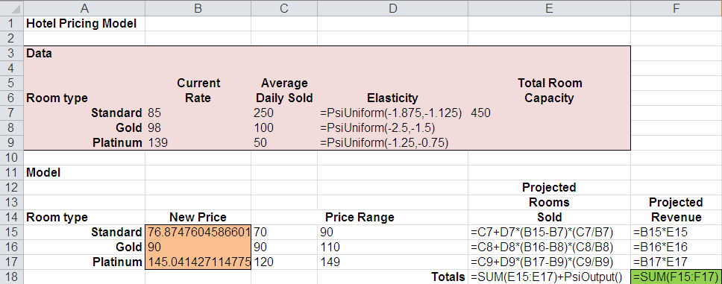
Risk Analysis Optimization
Example 17.5 (continued) Simulating the Optimal Solution to the Hotel Pricing Model
From Figure 17.11

Slide 25
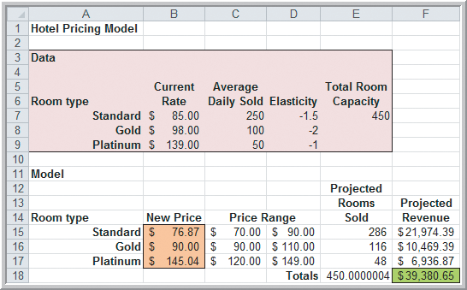
Risk Analysis Optimization
Example 17.5 (continued) Simulating the Optimal Solution to the Hotel Pricing Model
The simulated model gives the same solution as the earlier model with constant price-demand elasticities.
Figure 17.11

Slide 26
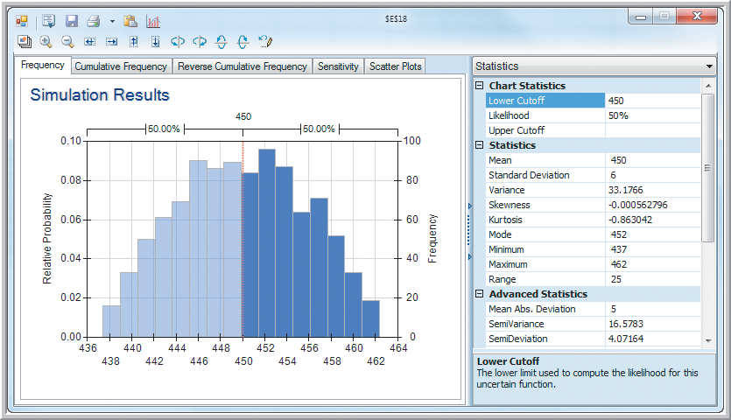
Risk Analysis Optimization
Example 17.5 (continued) Simulating the Optimal Solution to the Hotel Pricing Model
The simulated model indicates there is a 50% probability of more than 450 rooms demanded.
Figure 17.12

Slide 27
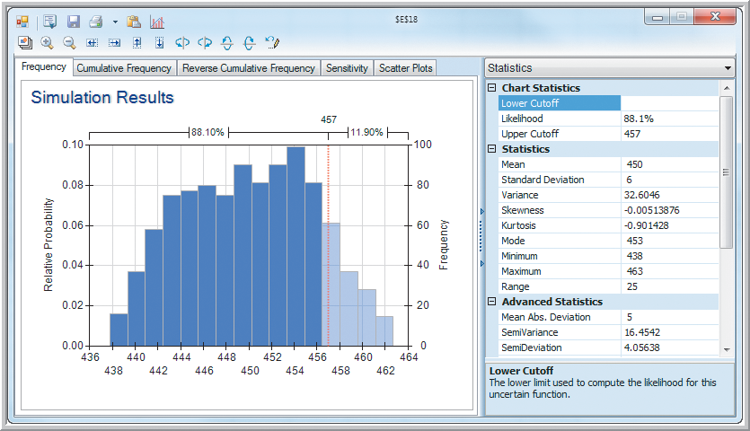
Risk Analysis Optimization
Example 17.6 Identifying Hotel Capacity to Meet Service Level Constraint
A service level of 88% requires 7 extra rooms.
Re-run the model with 443 rooms.
Figure 17.13

Slide 28
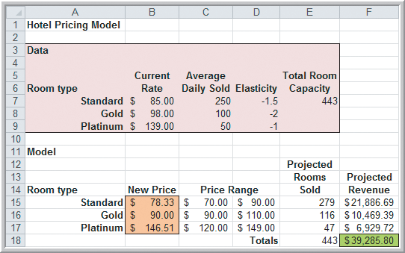
Risk Analysis Optimization
Example 17.6 (continued) Identifying Hotel Capacity to Meet Service Level Constraint
Simulated solution with a maximum of 443 rooms.
Figure 17.14

Slide 29
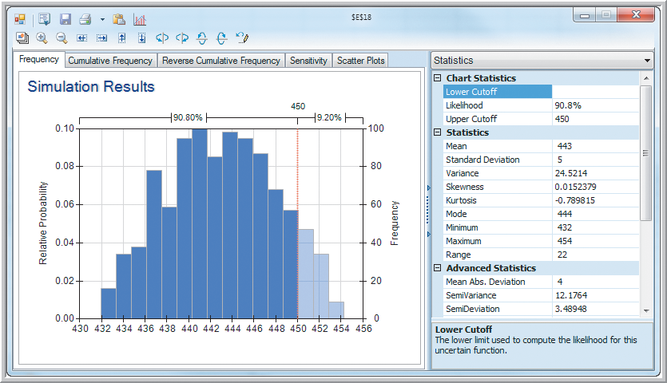
Risk Analysis Optimization
Example 17.6 (continued) Identifying Hotel Capacity to Meet Service Level Constraint
With 443 rooms, there is a 9.2% probability of more than 450 rooms demanded.
The hotel should not book more than 443 rooms in advance.
Figure 17.15

Slide 30
Optimizing Monte Carlo Simulation Models
Multiple Parameterized Simulations
Risk Solver Platform provides a capability of automatically running simulations for a range of values for decision variables.
Risk Solver will identify the optimal values of the decision variables.
In the Newsvendor Model, for example, we can vary purchase quantities of the candy boxes to determine the optimal number to purchase.
In the Hotel Overbooking Model, we can find the best number of reservations to accept.

Slide 31
Optimizing Monte Carlo Simulation Models
Example 17.7
Using Multiple Parameterized Simulations
Newsvendor Model from Chapters 8 and 11
A small candy store sells Valentine’s Day gift boxes that cost $12 and sell for $18.
In the past, at least 40 boxes have sold by Valentine’s Day but the actual amount is unknown.
After the holiday, boxes are discounted 50%.
Net profit = 18(min{Q,D}) + 9(max{0,Q−D}) − 12Q
where Q = quantity purchased and D = demand.

Slide 32
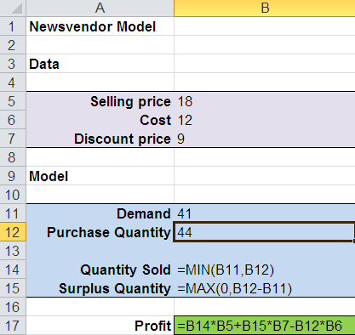
Optimizing Monte Carlo Simulation Models
Example 17.7 (continued)
Using Multiple Parameterized Simulations
Now we want to find the optimal purchase quantity by varying purchase quantity between 40 and 51.
Select cell B12.
Risk Solver
Parameters
Simulation
Values or Lower: 40
Upper: 51
Options
All Options
Simulation
Simulations to Run: 12
From Figure 17.16

Slide 33
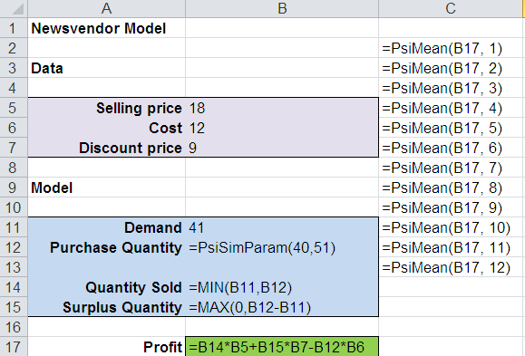
Optimizing Monte Carlo Simulation Models
Example 17.7 (continued)
Using Multiple Parameterized Simulations
Select cell B17.
Results
Statistics
Mean
Select cells C2:C13
(for the 12 simulated
mean profit values)
Simulation
Run Once
From Figure 17.16

Slide 34
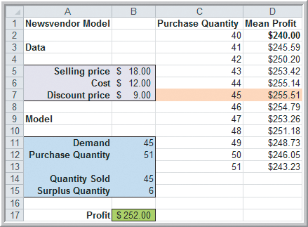
Optimizing Monte Carlo Simulation Models
Example 17.7 (continued)
Using Multiple Parameterized Simulations
Profit is maximized when 45 boxes of candy are purchased.
The newsvendor should purchase one more box next year.
Figure 17.16

Slide 35
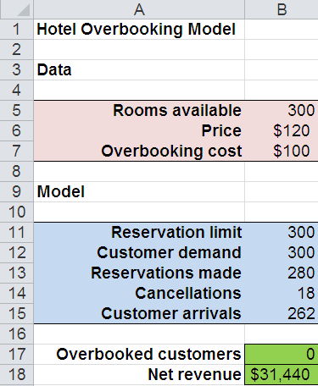
Optimizing Monte Carlo Simulation Models
Example 17.8
Optimizing the Hotel Overbooking Model
For a hotel with 300 rooms, find the number of reservations that maximize net revenue.
Select cell B13.
Risk Solver
Parameters
Simulation
Values or Lower: 300
Upper: 330
Options
All Options
Simulation
Simulations to Run: 31
From Figure 17.17

Slide 36
Optimizing Monte Carlo Simulation Models
Example 17.8 (continued)
Optimizing the Hotel Overbooking Model
Select cell B17.
Results
Statistics
Mean
Select cells G2:G32
Repeat for cell B18
selecting H2:H32.
Simulation
Run Once
From Figure 17.17

Slide 37
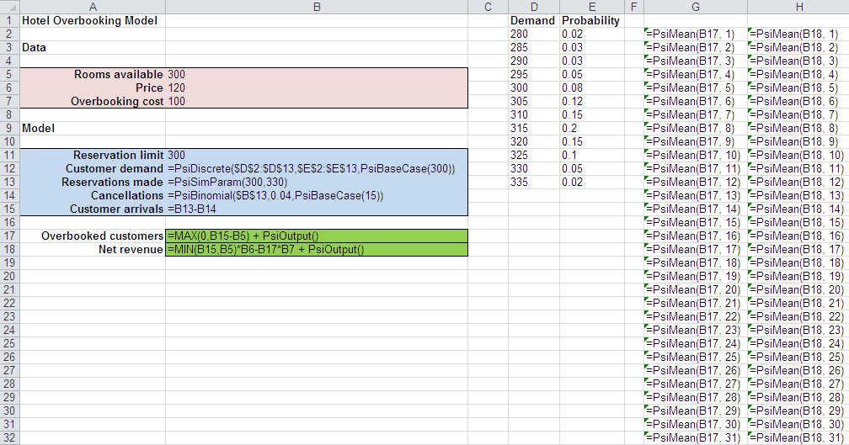
Optimizing Monte Carlo Simulation Models
Example 17.8 (continued)
Optimizing the Hotel Overbooking Model
From Figure 17.17

Slide 38
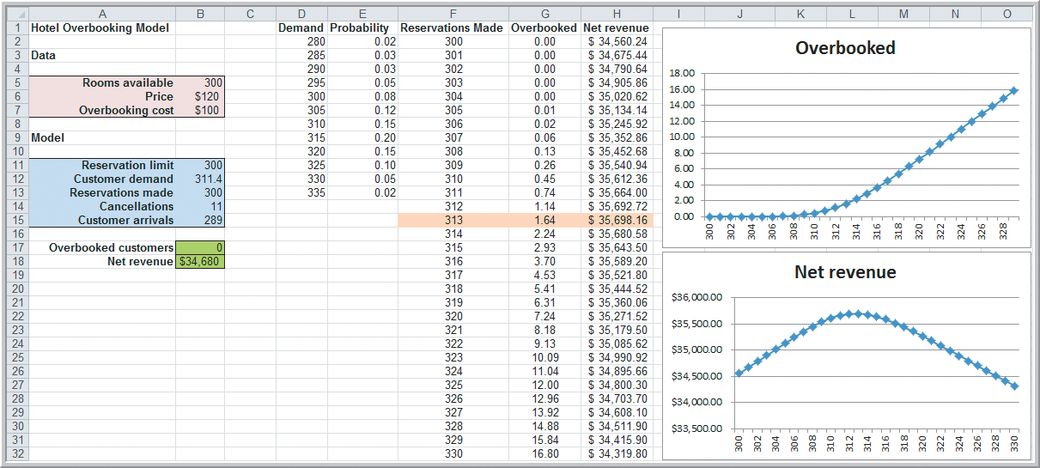
Optimizing Monte Carlo Simulation Models
Example 17.8 (continued)
Optimizing the Hotel Overbooking Model
Accepting 313 reservations maximizes net revenue.
Figure 17.17

Slide 39
Simulation Optimization Using Risk Solver Platform
Example 17.9
Optimizing the Hotel Overbooking Model (Part 2)
In Example 17.8, multiple parameterized simulations were used for optimization.
Risk Solver allows for more direct optimization.
We can use a simulation optimization approach to find the optimal number of reservations to accept.
First, specify bounds on the number of reservations (from 300 to 330).
Then optimize with respect to net revenue.

Slide 40
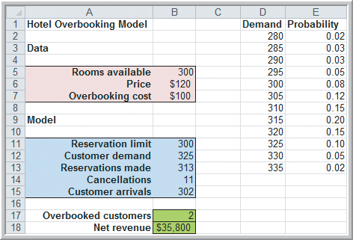
Simulation Optimization Using Risk Solver Platform
Example 17.9 (continued)
Optimizing the Hotel Overbooking Model (Part 2)
Select cell B13.
Decisions
Normal
Constraints
Type/Bound
Integer
>= 300
<= 330
Select cell B18.
Objective
Max Expected
Figure17.18
Again, accepting 313 reservations maximizes net revenue.
Choose Optimize

Slide 41
Simulation Optimization Using Risk Solver Platform
Portfolio Allocation Models
These models determine how to allocate an investment among a variety of assets.
Each asset has an expected annual return and a level of risk in meeting that return estimate.
Arbitrate pricing theory provides estimates of the sensitivity of investments to risk factors such as inflation, industrial production, interest rates, etc.
Maximizing return subject to the risk tolerance of the investor is typically the objective.

Slide 42
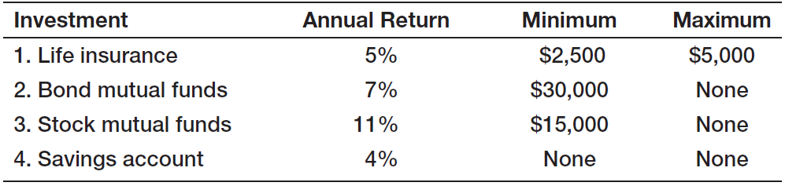
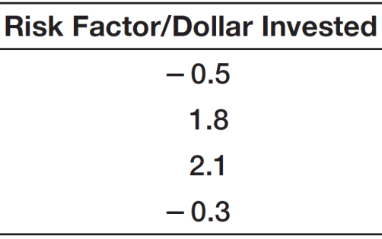
Simulation Optimization Using Risk Solver Platform
Example 17.10 Setting Up the Spreadsheet Model
An investor has $100,000 to invest.
Four assets are under consideration.
The investor will tolerate a weighted risk per dollar invested of at most 1.
Find the allocation that maximizes return subject to the limitation on weighted risk.

Slide 43
Simulation Optimization Using Risk Solver Platform
Example 17.10 (continued)
Setting Up the Spreadsheet Model
Define X_{i} as the amount invested in asset i
Maximize 0.05X₁ + 0.07X₂ + 0.11X₃ + 0.04X₄
X₁ + X₂ + X₃ + X₄ ≤ 100,000
− 0.5X₁ + 1.8X₂ + 2.1X₃ − 0.3X₄ ≤ X₁+X₂+X₃+X₄
2,500 ≤ X₁ ≤ 5,000
X₂ ≥ 30,000
X₃ ≥ 15,000
X₄ ≥ 0

Slide 44
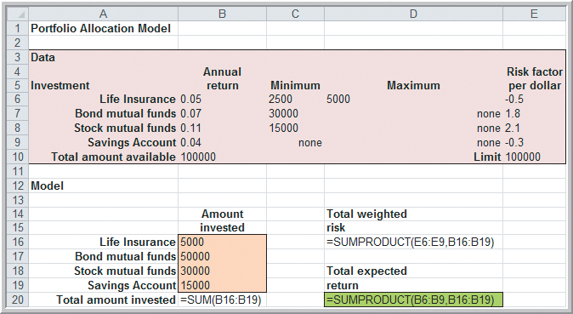
Simulation Optimization Using Risk Solver Platform
Example 17.10 (continued)
Setting Up the Spreadsheet Model
Figure 17.19b

Slide 45
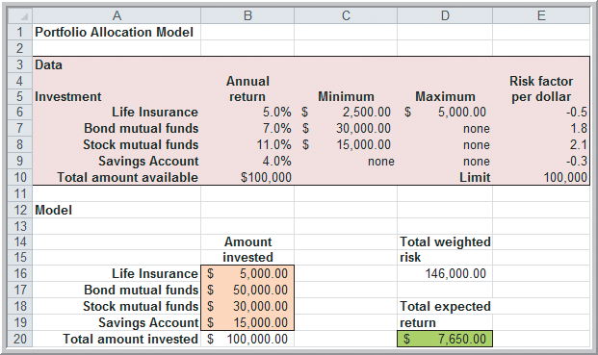
Simulation Optimization Using Risk Solver Platform
Example 17.10 (continued)
Setting Up the Spreadsheet Model
The current solution to the problem is not feasible.
The weighted risk per dollar invested (1.46) exceeds 1.
Figure 17.19a

Slide 46
Simulation Optimization Using Risk Solver Platform
Example 17.11 Setting Up the Simulation Model
For the Portfolio Allocation Model in the previous example, assume that annual returns are uncertain for all but the savings account.
Life insurance returns are uniformly distributed.
→ Cell B6: =PsiUniform(4%, 6%)
Bond mutual fund returns are normally distributed.
→ Cell B7: = PsiNormal(7%, 1%)
Stock fund returns are lognormally distributed.
→ Cell B8: = PsiLogNormal(11%, 4%)
Also, define Cell D20 (total expected return) as an uncertain output cell by adding +PsiOutput()

Slide 47
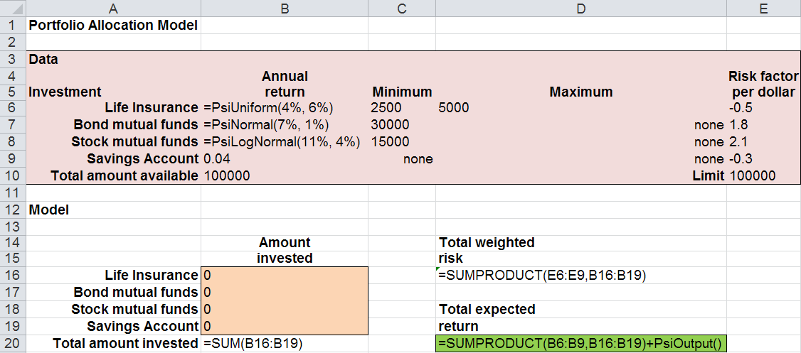
Simulation Optimization Using Risk Solver Platform
Example 17.12 Setting Up the Optimization Model
for the Portfolio Allocation Model
From Figure 17.20

Slide 48
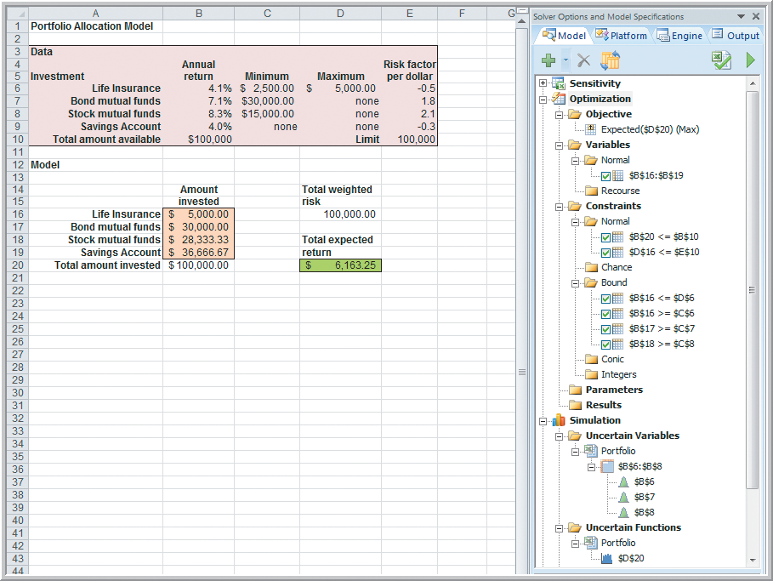
Simulation Optimization Using Risk Solver Platform
Example 17.12 (continued) Setting Up the Model
Objective:
Max D20
(Expected)
Decision
Variables:
B16:B19
Constraints:
B20 <= B10
D16 <= E10
Bounds:
B16 <= D6
B16 >= C6
B17> = C7
B18 >= C8
Figure 17.20

Slide 49
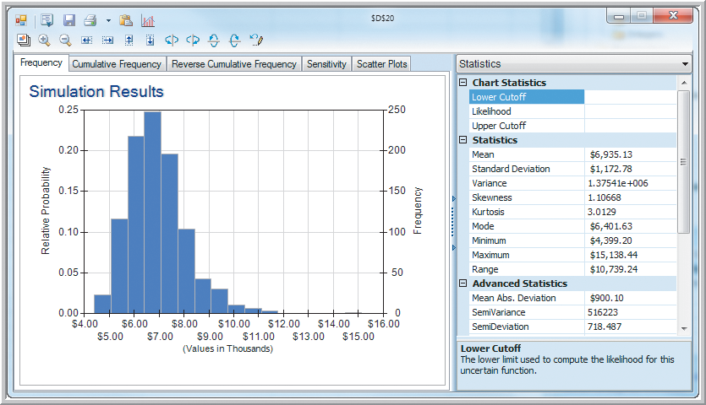
Simulation Optimization Using Risk Solver Platform
Example 17.12 (continued)
Setting Up the Optimization Model
$6,935 is the mean simulated total return.
There is a very small chance of exceeding a $10,000 return.
Figure 17.21

Slide 50
Simulation Optimization Using Risk Solver Platform
Project-Selection with Uncertainty
Project-selection and capital-budgeting projects typically have many uncertainties because they involve future events.
Returns and resource requirements are often uncertain estimates.
Implementing a project is not guarantee of successful completion.
Evolutionary Solver, which searches a feasible space for an optimal solution, allows for the incorporation of uncertainties in these models.

Slide 51
Simulation Optimization Using Risk Solver Platform
Example 17.13
A Project-Selection Model with Uncertainty
Recall Example 15.5 Hahn Engineering
Five potential projects were being considered.
Cash and personnel requirements did not allow selection of all 5 projects.
The objective was to determine which projects to select in order to maximize expected return.
Define X_{i} as binary: X_{i} = 1 if project i is selected
X_{i} = 0 if project i not selected

Slide 52
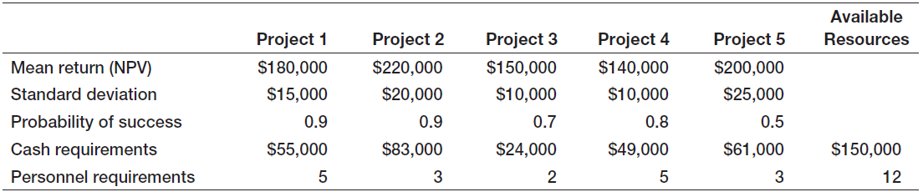
Simulation Optimization Using Risk Solver Platform
Example 17.13 (continued)
A Project-Selection Model with Uncertainty
Suppose the mean returns are uncertain and can be modeled using lognormal distributions.
Also, the probability of completing a selected project is not 100% and varies by project.
Table 17.1

Slide 53
Simulation Optimization Using Risk Solver Platform
Example 17.13 (continued)
A Project-Selection Model with Uncertainty
To model whether a project is successful, use a binomial probability distribution with n = 1.
Use IF statements to apply the returns and success probabilities only to “selected” projects.
Specify total return as a changing output cell.
Solve the model using both simulation and Evolutionary Solver.

Slide 54
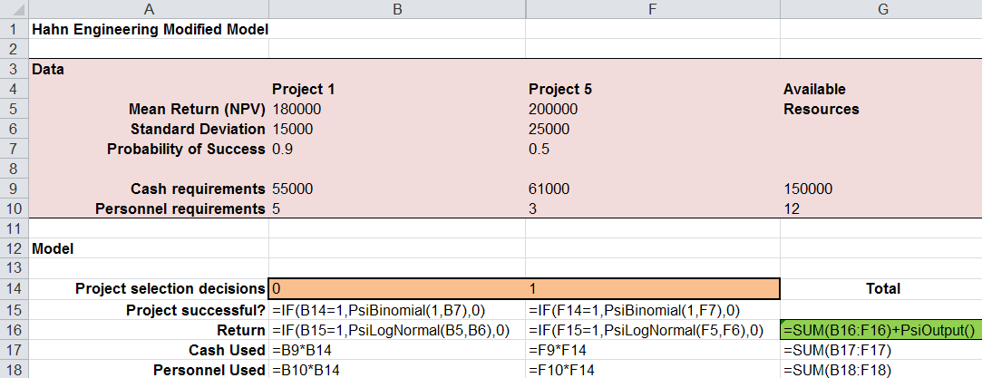
Simulation Optimization Using Risk Solver Platform
Example 17.13 (continued)
A Project-Selection Model with Uncertainty
Spreadsheet formulation with columns C-E hidden.

Slide 55
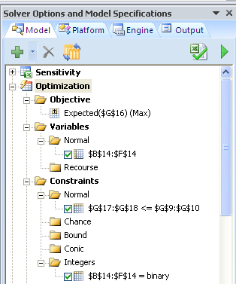
Simulation Optimization Using Risk Solver Platform
Example 17.13 (continued)
A Project-Selection Model with Uncertainty
Objective:
Maximize Expected Return (G16)
Decision Variables:
Normal (B14:F14)
Constraints:
Cash used ≤ available (G17 ≤ G9)
Personnel used ≤ available (G18 ≤ G10)
Integers
Binary (B14:F14)

Slide 56
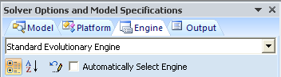
Simulation Optimization Using Risk Solver Platform
Example 17.13 (continued)
A Project-Selection Model with Uncertainty
To solve using Evolutionary Solver
Solver Options and Model Specifications:
Engine
Standard Evolutionary Engine
Optimize
Solve complete problem
To solve using simulation
Simulate
Run Once

Slide 57
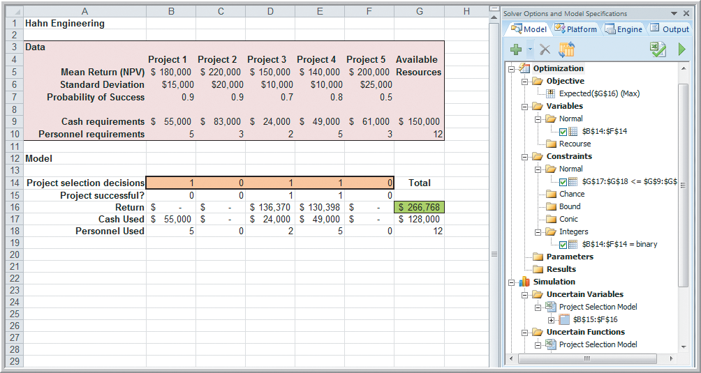
Simulation Optimization Using Risk Solver Platform
Example 17.13 (continued)
A Project-Selection Model with Uncertainty
Evolutionary
Solver result
Mean Return
= $266,768
Select projects
1, 3, and 4.
Project 1 is not successful.
Figure 17.22

Slide 58
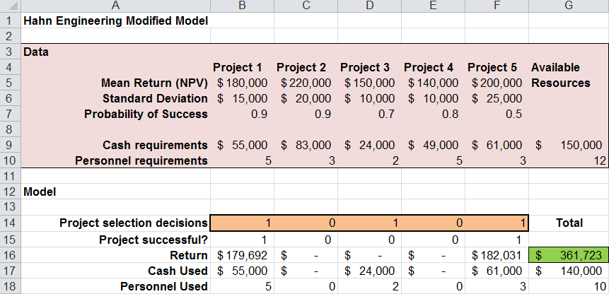
Simulation Optimization Using Risk Solver Platform
Example 17.13 (continued)
A Project-Selection Model with Uncertainty
Improved Evolutionary
Solver result
Mean Return
= $361,723
Select projects
1, 3, and 6.
Project 3 is not successful.

Slide 59
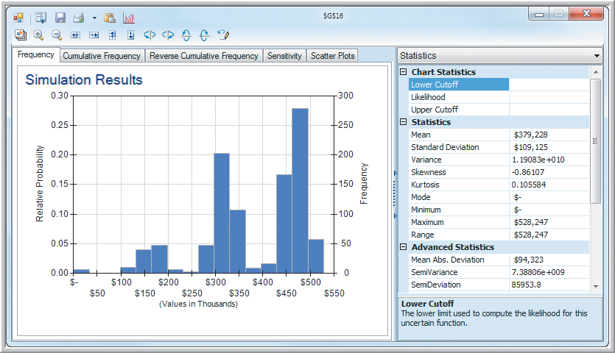
Simulation Optimization Using Risk Solver Platform
Example 17.13 (continued)
A Project-Selection Model with Uncertainty
Simulation Result
Mean Return
= $379,228
We see 4 separate return distributions, depending on whether 0,1,2, or 3 projects are successful.
Figure 17.23

Slide 60
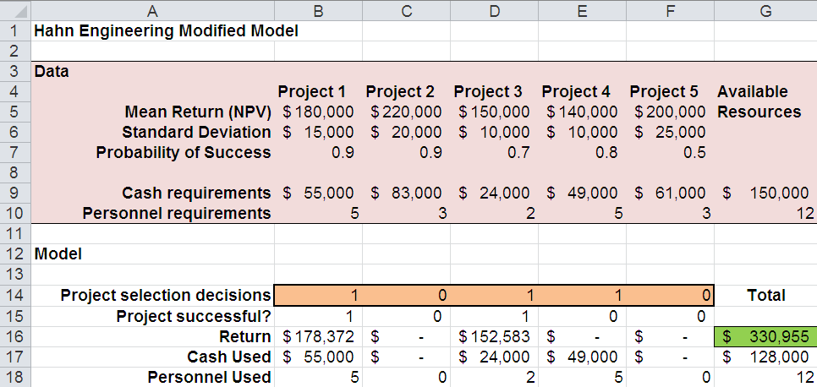
Simulation Optimization Using Risk Solver Platform
Example 17.13 (continued)
A Project-Selection Model with Uncertainty
Another Simulated Solution
Mean Return
= $330,956
Select projects
1, 3, and 4.
Project 4 is not successful.

Slide 61
Chapter 17 - Key Terms
Chance constraint
Conditional value at risk (CVaR)
Multiple parameterized simulation
Service level
Value at risk (VaR)

Slide 62
Case Study Performance Lawn Equipment (17)
Recall that PLE produces lawnmowers and a medium size diesel power lawn tractor.
The production plan developed in case (13) needs to be updated to reflect stochastic rather than constant assembly and painting times.
Additionally, the amount of sheet metal used for both mower and tractor housings should be considered stochastic variables as well.
Revise the production plan and write a formal report summarizing your results.

Slide 63


